Slide 1
ADHIYAMAAN COLLEGE OF ENGINEERING (AUTONOMOUS)
DEPARTMENT OF COMPUTER SCIENCE AND ENGINEERING
NALAIYA THIRAN PROJECT FIRST REVIEW
AI-Powered Nutrition Analyzer For Fitness
Enthusiasts
TEAM MEMBERS:
Akshaya R
Asif M S
Harikarasudhan K
Harini T D
Imthiyas F
PROJECT GUIDE :
Vijaya Lakshmi D M

Slide 2
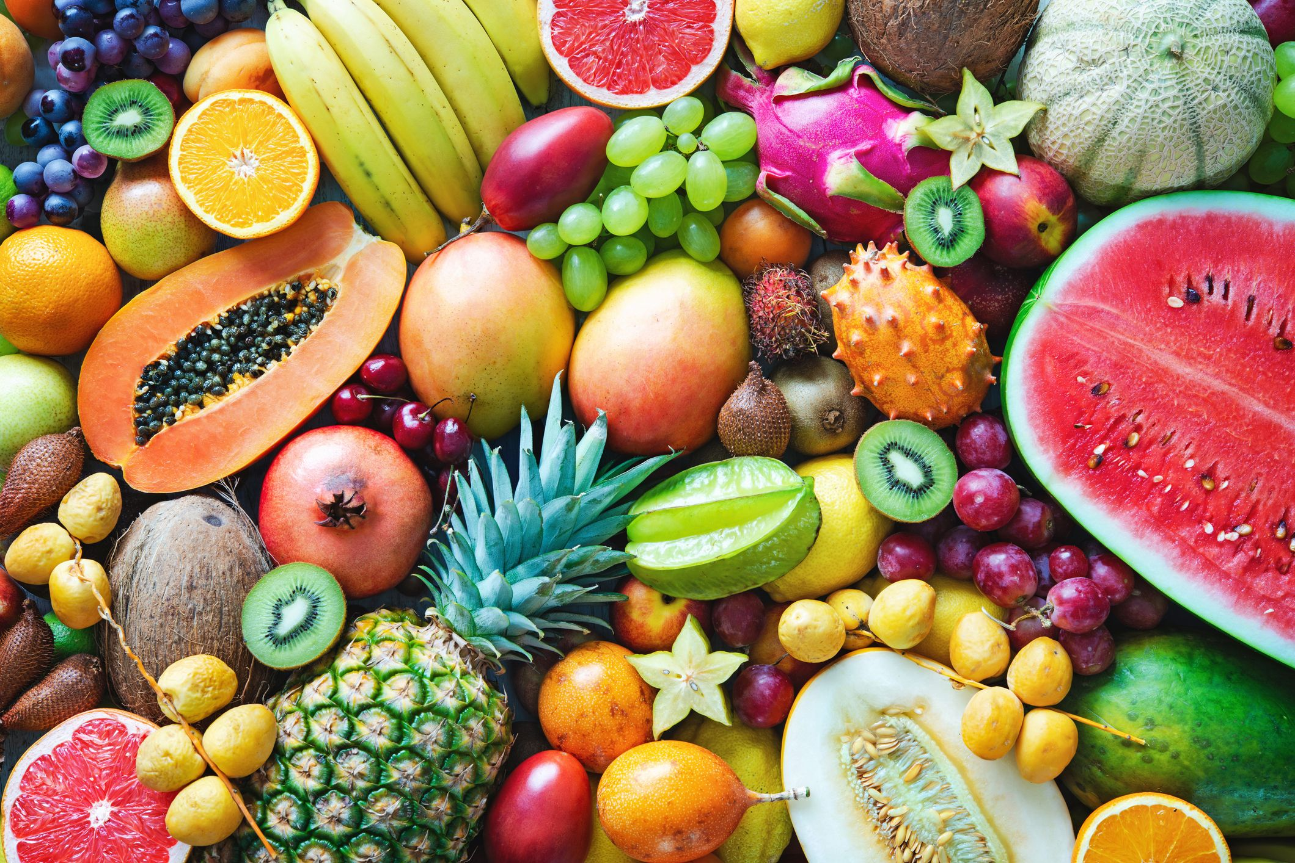
ABSTRACT
Food is essential for human life and has been the concern of many healthcare conventions.
Nutritional analysis is the process of determining the nutritional content of food.
Our project is based on deep learning where we use convolution neural network (CNN) algorithm for detecting the nutrition based on the captured image of fruit.
All the modules intergrated through IBM WATSON which acts as a question answering machine.
Nutrition analysis are stored in IBM cloud for keeping track on nutrition pattern.

Slide 3
LITRATURE SURVEY
1.Author: Raikwar H., Jain H. and Baghel,A.
Title: Calorie Estimation from Fast Food Images Using Support Vector Machine
Year: 2019
Proposed a model which focused on estimation of number of calories in the food item by just taking its image as
input using SVM. The proposed model applies some techniques of image processing followed by feature
extraction. The authors designed the dataset, applied this dataset to some image processing techniques, then
processed dataset is applied to the feature extraction process. The features extracted from all the images are
then applied to the classifier support vector machine (SVM) which classifies the images in different classes as
specified in the learning algorithm.
2.Author:J R Rajayogi ,G Manjunath, G Shobha
Title: Indian Food Image Classification with Transfer Learning
Year: 2019
In this paper image classification is performed on Indian food dataset using different transfer learning techniques.Unlike the traditional methods of building a model from the scratch, pre trained models are used in this project which saves the computation time and cost and also has given better results. The Indian food dataset of 20 classes with 500 images in each class is used for training and validating. The models used are IncceptionV3, VGG16, VGG19 and ResNet

Slide 4
3.Author: Pathanjali, C., Salis, V.E., Jalaja, G. and Latha, A.
Title: A Comparative Study of Indian Food Image Classification Using K-Nearest-Neighbour and Support_x0002_Vector-Machines
Year: 2020
Proposed an automatic food detection system that detects and recognizes varieties of Indian food. The
proposed food recognition system is developed in such a way that it can classify the Indian food items based
on two different classification models i.e., SVM and KNN. The proposed system uses a combined colour and
shape features. A comparative study on the performance of both the classification models is performed.
Parameters such as food density tables, colour, and shape acknowledgment as a part of image processing,
and classification with the SVM and KNN have been considered. The data set contains the feature vector
extracted from the sample images

Slide 5
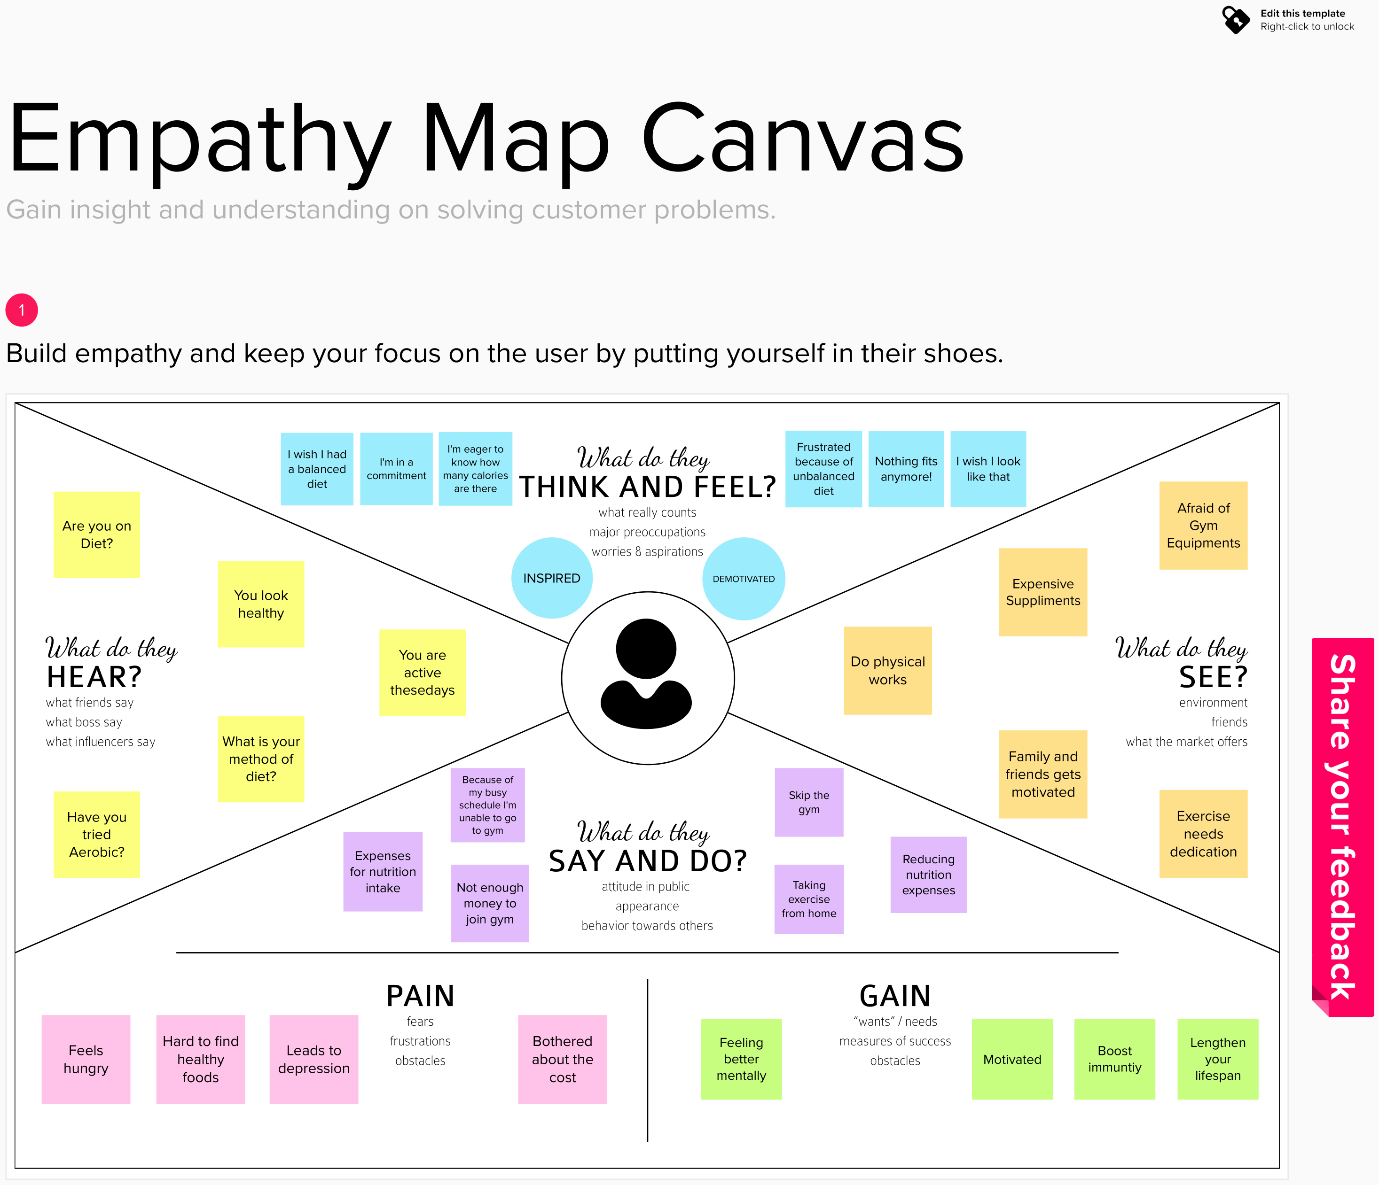
EMPATHY MAP
Enter title
Click here to add content of the text, and brief explain your point of view.Click here to add content of the text, and brief explain your point of view.

Slide 6
PROPOSED SOLUTION
In this project , I propose an assistive nutrition level tracking system to help
fitness enthusiasts succeed in their fight against diet-related health conditions.
The main aim of the project is to build a model which is used for classifying the fruit depending on the different characteristics like colour, shape, texture etc.
Here the user can capture the images of different fruits and then the image will be sent the trained model. The model analyses the image and detect the nutrition based on the fruits like (Sugar, Fibre, Protein, Calories, etc.).
It is deep learning based system where we use CNN algorithm to classify and further using it to satisfy the need to measures daily nutrition intake value.
The value of nutrition intake are recorded.
Hence, we proposed a measurement method to estimate the amount of nutrition
from different fruit images.
Also help the user to understand their daily nutrition intake and further help maintaing their diet according to the record.
Enter title

Slide 7
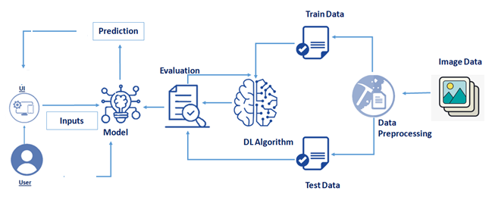
SOLUTION ARCHITECTURE

Slide 8
THANK YOU

